Slide 1
Class 2 – OS-Related Hardware & Software
The Process Concept
Osama Hosam
Taiba University

Slide 2
Lecture 2 overview
OS-Related Hardware & Software
  Complications in real systems
  Brief introduction to
    memory protection and relocation
    virtual memory & MMUs
    I/O & Interrupts
The “process” abstraction
Process scheduling
Process states
Process hierarchies

Slide 3
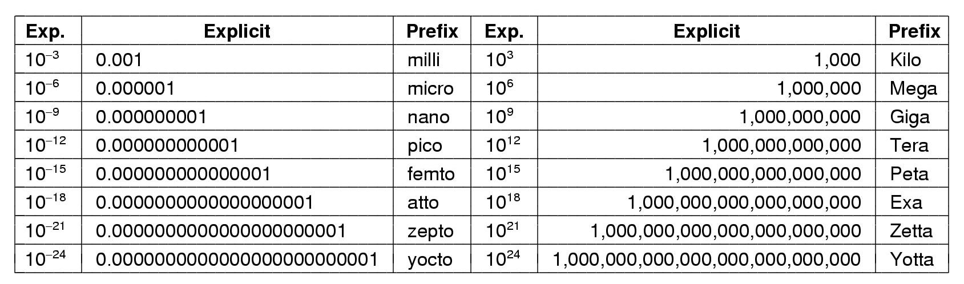
Terminology review - metric units
The metric prefixes

Slide 4
Memory protection and relocation

Slide 5
Memory protection and relocation ...
Memory protection – the basic ideas
  virtual vs physical addresses
    address range in each application starts at 0
  Possible solution with base and limit registers
    “base register” used to convert each virtual address to a physical address before main memory is accessed
    address is compared to a “limit register” to keep memory references within bounds
  Relocation
    by changing the base register value
  Paged virtual memory
    same basic concept, but more powerful (and complex)

Slide 6
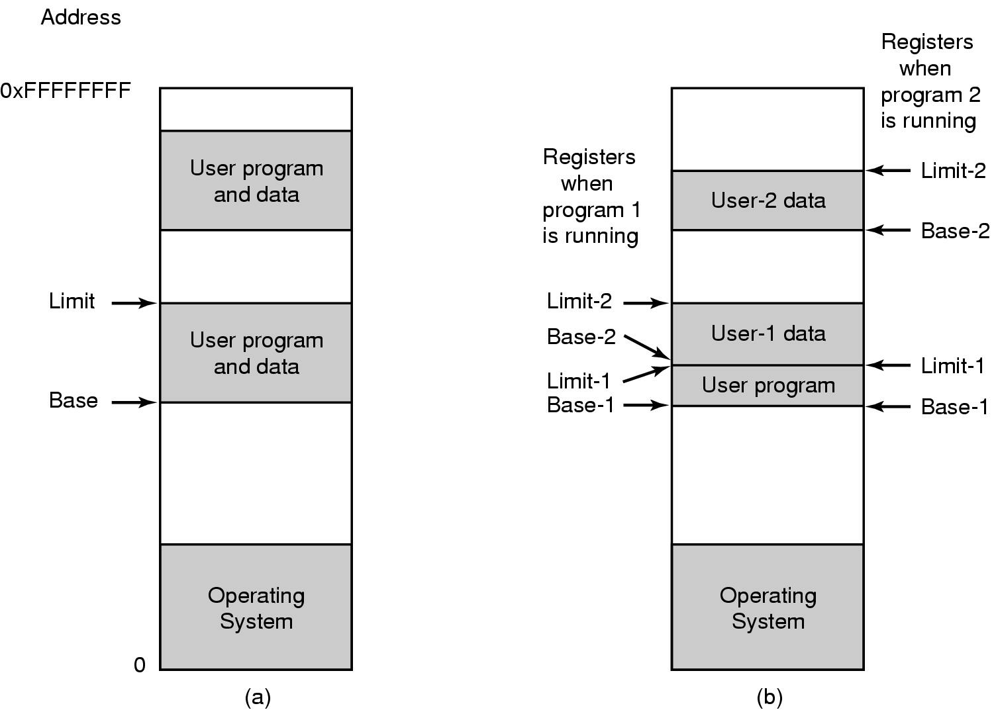
Base & Limit Registers (single & multiple)

Slide 7
Virtual memory and MMUs
Memory management unit (MMU)
  hardware provided equivalent of multiple base registers
  at the granularity of “pages” of memory, say 2kB, i.e., lots of them!
  supports relocation at page granularity by replacing high order address bits
  applications need not occupy contiguous physical memory
Memory protection
  limit registers don’t work in this context
  per-page and per-application protection registers
Relocation and protection checking occur at CPU speed!

Slide 8

What about I/O devices?
Monitor
Bus
A simplified view of a computer system

Slide 9
How do programs interact with devices?
Why protect access to devices by accessing them indirectly via the OS?
Devices vs device controllers vs device drivers
  device drivers are part of the OS (ie. Software)
  programs call the OS which calls the device driver
Device drivers interact with device controllers
  either using special IO instructions
  or by reading/writing controller registers that appear as memory locations
  Device controllers are hardware
  They communicate with device drivers via interrupts

Slide 10
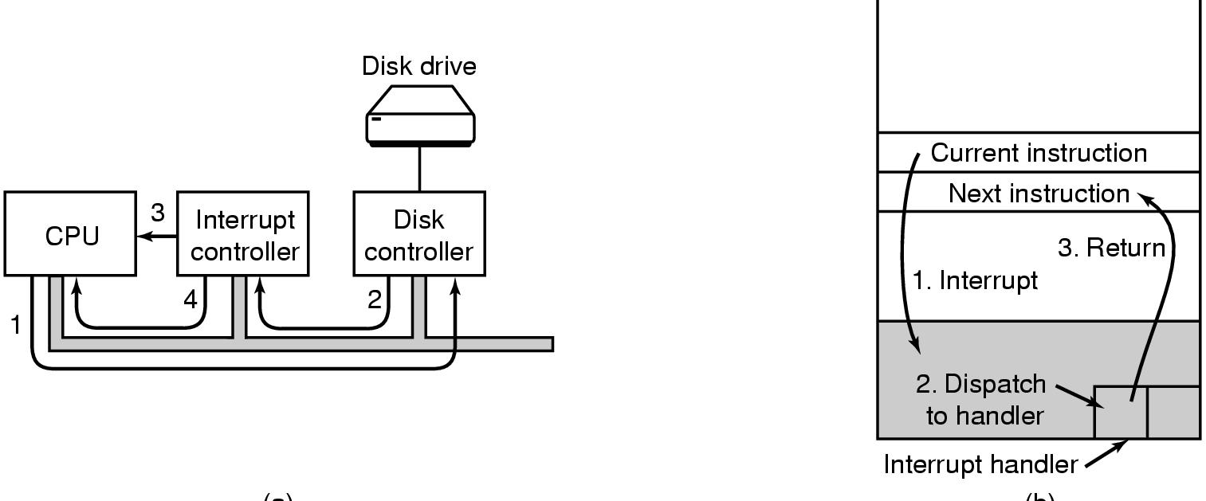
How do devices interact with programs?
Interrupts

Slide 11
Different types of interrupts
Timer interrupts
  Allows OS to keep control after calling app’ code
  One way to keep track of time
I/O interrupts
  Keyboard, mouse, disks, network, etc…
Hardware failures
Program generated (traps & faults)
  Programming errors: seg. faults, divide by zero, etc.
  System calls like read(), write(), gettimeofday()
Notes:
Allows multiple things to concurrently happen… also makes things more complex!!!

Slide 12
System calls
System calls are the mechanism by which programs communicate with the O.S.
Implemented via a TRAP instruction
Example UNIX system calls:
  open(), read(), write(), close()
  kill(), signal()
  fork(), wait(), exec(), getpid()
  link(), unlink(), mount(), chdir()
  setuid(), getuid(), chown()

Slide 13
The inner workings of a system call
User-level code
Process usercode
{
...
read (file, buffer, n);
...
}
Procedure read(file, buff, n)
{
...
read(file, buff, n)
...
}
_read:
LOAD r1, @SP+2
LOAD r2, @SP+4
LOAD r3, @SP+6
TRAP Read_Call
Library code

Slide 14
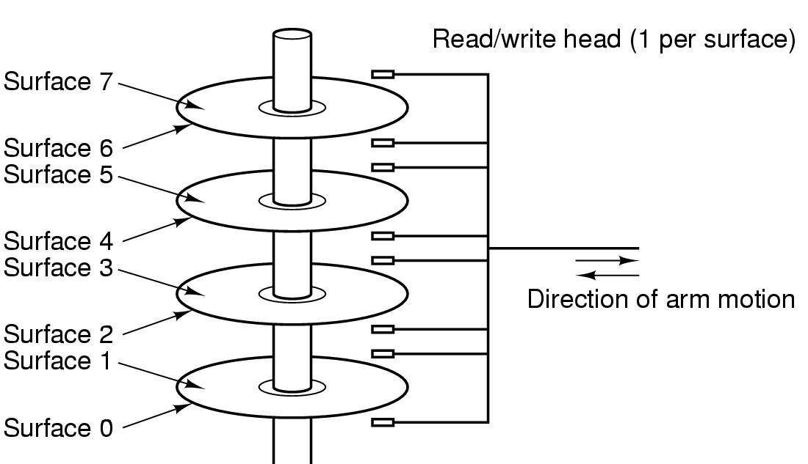
What about disks and file storage?
Structure of a disk drive

Slide 15
Disks and file storage
Manipulating the disk device is complicated
  hide some of the complexity behind disk controller, disk device driver
Disk blocks are not a very user-friendly abstraction for storage
  contiguous allocation may be difficult for large data items
  how do you manage administrative information?
One application should not (automatically) be able to access another application’s storage
  OS needs to provide a “file system”

Slide 16
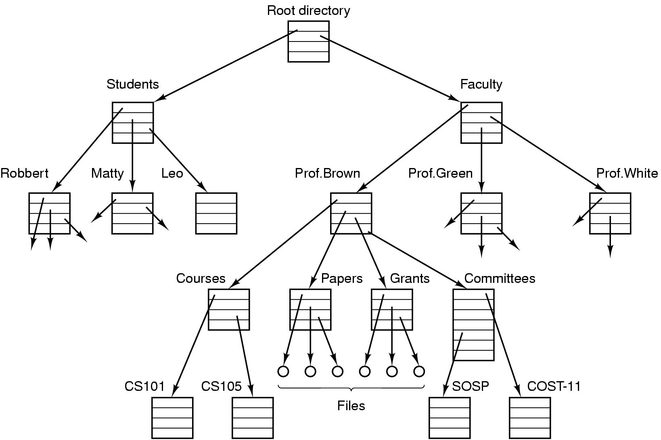
File systems
File system - an abstraction above disk blocks

Slide 17
What about networks?
Network interfaces are just another kind of shared device/resource
Need to hide complexity
  send and receive primitives, packets, interrupts etc
  protocol layers
Need to protect the device
  access via the OS
Need to allocate resources fairly
  packet scheduling

Slide 18
The Process Concept

Slide 19
The Process Concept
Process – a program in execution
  Program
      description of how to perform an activity
      instructions and static data values
  Process
      a snapshot of a program in execution
      memory (program instructions, static and dynamic data values)
      CPU state (registers, PC, SP, etc)
      operating system state (open files, accounting statistics etc)

Slide 20
Process address space (Process Control Block PCB)
Each process runs in its own virtual memory address space that consists of:
  Stack space – used for function and system calls
  Data space – variables (both static and dynamic allocation)
  Text – the program code (usually read only)
Invoking the same program multiple times results in the creation of multiple distinct address spaces
stack
Address
space
data
text

Slide 21
Switching among multiple processes
Saving all the information about a process allows a process to be temporarily suspended and later resumed from the same point
Memory
CPU
Prog2
Code
ALU
Prog1
Code
Prog2
Data
Prog1
Data
SP
PC
OS suspends Prog1
Prog1
State
Prog2
State

Slide 22
Switching among multiple processes
Saving all the information about a process allows a process to be temporarily suspended and later resumed from the same point
Memory
CPU
Prog2
Code
ALU
Prog1
Code
Prog2
Data
Prog1
Data
SP
PC
OS resumes Prog2
Prog1
State
Prog2
State

Slide 23

Why use the process abstraction?
Multiprogramming of four programs in the same address space
Conceptual model of 4 independent, sequential processes
Only one program active at any instant

Slide 24
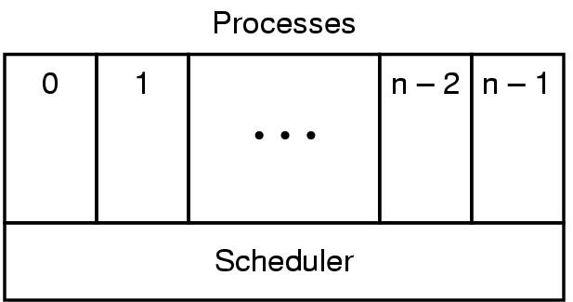
The role of the scheduler
Lowest layer of process-structured OS
  handles interrupts & scheduling of processes
Sequential processes only exist above that layer

Slide 25
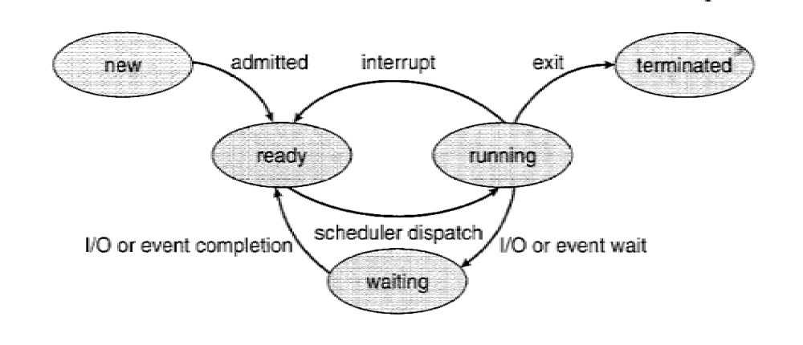
Process states
Possible process states
  Waiting
  Ready
  Running

Slide 26
How do processes get created?
Principal events that cause process creation
System initialization
Initiation of a batch job
User request to create a new process
Execution of a process creation system call from another process

Slide 27
Process hierarchies
Parent creates a child process,
  special system calls for communicating with and waiting for child processes
  each process is assigned a unique identifying number or process ID (PID)
Child processes can create their own child processes
  Forms a hierarchy
  UNIX calls this a "process group"
  Windows has no concept of process hierarchy
    all processes are created equal

Slide 28
How do processes terminate?
Conditions which terminate processes
Normal exit (voluntary)
Error exit (voluntary)
Fatal error (involuntary)
Killed by another process (involuntary)

Slide 29
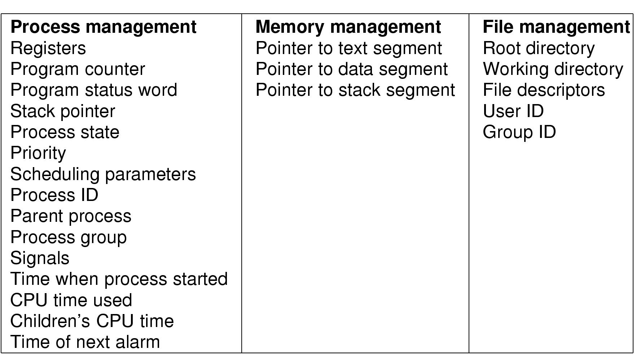
What other process state does the OS manage?
Example fields of a process table entry for successful process switch

Slide 30
What to do before next class
Reading for next week’s class - pages 117-128

